Slide 1
Prevenzione delle SSI in chirurgia d’urgenza
Paolo prosperi
Chirurgia d’urgenza
Azienda ospedaliero-universitaria careggi
firenze

Slide 2
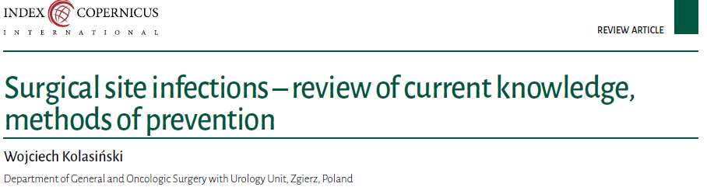
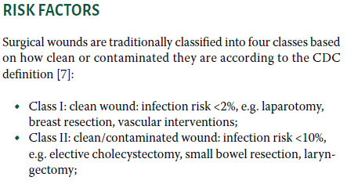
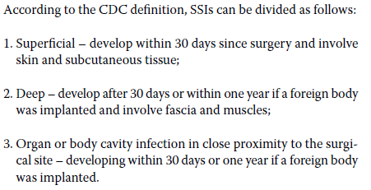
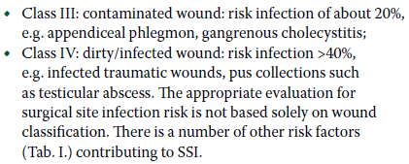
2018
Notes:
Le infezioni del sito chirurgico sono l’infezione acquisita in ospedale più comune e, secondo recenti studi si verifica nel 2-11% degli interventi chirurgici. Queste sono associate con un aumento dei costi del trattamento, aumento della durate della degenza e un aumento della mortalità.
Le infezioni del sito chirurgico si possono dividere in tre categorie:
Superficial – develop within 30 days since surgery and involve skin and subcutaneous tissue;
Deep – develop after 30 days or within one year if a foreign body was implanted and involve fascia and muscles;
Organ or body cavity infection in close proximity to the surgical site – developing within 30 days or one year if a foreign body was implanted.
Per questo motivo, il tipo di ferite è stato diviso in quattro classi sulla base della contaminazione
Class I: clean wound: infection risk <2%, e.g. laparotomy, breast resection, vascular interventions;
Class II: clean/contaminated wound: infection risk <10%, e.g. elective cholecystectomy, small bowel resection, laryngectomy;
Class III: contaminated wound: risk infection of about 20%, e.g. appendiceal phlegmon, gangrenous cholecystitis;
Class IV: dirty/infected wound: risk infection >40%, e.g. infected traumatic wounds, pus collections such as testicular abscess.
The appropriate evaluation for surgical site infection risk is not based solely on wound classification.

Slide 3
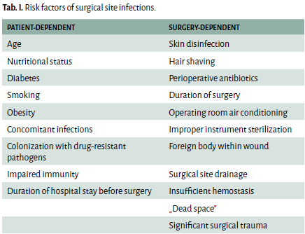
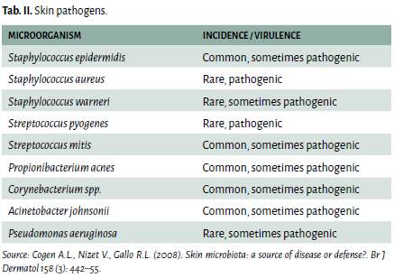
Notes:
There is a number of other risk factors (Tab. I.) contributing to SSI.
La cute stessa in realtà è colonizzata da vari microrganismi. La maggior parte di essi sono innocui o anzi benefici per l’ospite. Ovviamente la colonizzazione della cute è molto variabile e dipende dalla localizzazione topografica, da fattori endogeni dell’ospite e da fattori ambientali.
I patogeni endogeni sono i principali responsabili per le infezioni del sito chirurgico. Includono batteri che normalmente si trovano sulla cute o a livello dell’organo sottoposto ad intervento chirurgico (tipo i batteri a livello dell’intestino).

Slide 4

Surgical site shaving
Nutrition
Immunosuppressive therapy
Antibiotic prophylaxis
Notes:
Cosa possiamo quindi fare nella fase preoperatoria per prevenire le infezioni del sito chirurgico:
- la tricotomia: Hair removal should be done only using an electric razor with a single-use tip, optimally right before transferring the patient to the OR.
- l’implemento della nutrizione: malnutrition was an important risk factor for surgical site infections. Obesity (BMI > 30) affects wound healing in many ways.
- la terapia immunosoppressiva: There are no uniform guidelines as to managing surgical patients on immunosuppressive therapy. In the study by Berthold et al., it was established that immunosuppressive therapy impairs wound healing and increases the risk of infections.
- Terapia antibiotica profilattica: Antibiotic prophylaxis is indicated for clean/contaminated wounds as well as clean wounds with implanted foreign objects (e.g. vascular or joint prosthesis). For contaminated and dirty wounds, the patient should be given not a prophylactic dose but rather a full course of antibiotics.

Slide 5

Operating room architecture
Surgical field asepsis
Hand disinfection
Blood transfusion
Maintaining patient’s homeostasis
Notes:
Prendiamo adesso in considerazione la fase intraoperatoria:
- La sala operatoria stessa: The proper microbiological regime is founded on limiting contamination of all surfaces with pathogens. The correctly designed operating room should have zones of increasing sterility. The personnel should walk through scrubbing areas in order to minimize contamination of the OR environment with hospital pathogens. The fundamental rule of OR organization is separation between ‚clean’ and ‚dirty’ parts.
- Il campo chirurgico asettico: The goal is to reduce the number of potential pathogens naturally residing on the skin and to limit their growth potential during and after surgery. Two most commonly used substances for preoperative skin decontamination are alcohol solutions of chlorhexidine gluconate and povidone iodine. Studies comparing chlorhexidine and povidone iodine proved that both substances show similar antibacterial spectrum. However, chlorhexidine acts longer by covalently bonding to skin and mucous membrane proteins. In the meta-analysis by Priviter et al. aimed at comparing alcohol solutions of chlorhexidine and povidone iodine, it was established that chlorhexidine use resulted in lower rate of surgical site infections.
- la disinfezione delle mani: the bacteria on the hands of the medical staff can be a source of hospital-acquired infections. Staphylococcus aureus and Gram negative bacilli are the main components of the superficial skin bacterial flora.
- le trasfusioni di sangue: According to the American College of Surgeons (ACS), an extensive blood loss is defined as a loss of 30–40% of the total blood volume (TBV). Perioperative blood loss leads not only to circulatory failure, but also to a significant loss of proteins, antibodies and coagulation factors. On the other hand, blood transfusion leads to two types of immune response in humans, namely immunosuppression and immunization. Hypoxia, deficiency of protein and albumin, which act as drug carriers, as well as changes in immune response all predispose to impaired wound healing and surgical site infections.
- l’omeostasi del paziente: sia in termini di glycemia, che in termini di temperature, che in termini di ossigenazione.

Slide 6
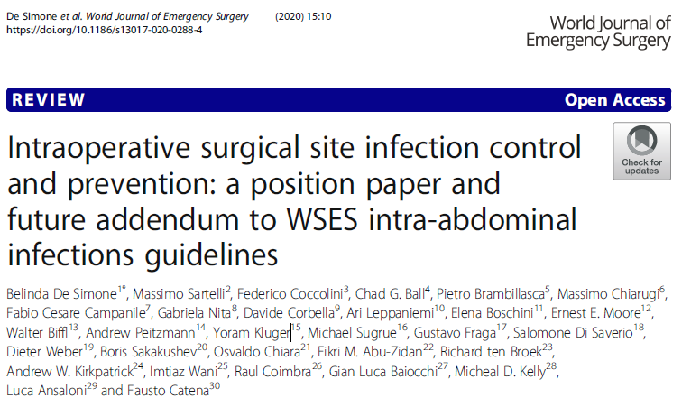

Slide 7
How to close a surgical incision?
There is no significant difference in terms of SSI incidence and length of hospital stay between patients in which the skin is sutured by continuous versus interrupted stitches (GoR 1B)
Superficial wound dehiscence is lower in subcuticular continuous suture versus interrupted stitches. (GoR 1B)
The use of steri-strips doesn't reduce the incidence of SSI
2) Coated sutures: are they useful?
Triclosan-coated sutures significantly reduce SSI prevalence compared with the non-coated sutures (GoR1B)

Slide 8
3) What is the role of intraoperative intraperitoneal irrigation vs topic wound lavage with antibiotic solutions to prevent surgical site infections?
There are insufficient data to to support the role of intraperitoneal the role of intraperitoneal or topic wound irrigation with antibiotics in preventing SSI
4) Could wound irrigation with saline and/or povidone iodine solution be useful to prevent surgical site infections?
There are insufficient data to determine the role of saline or povidone solution irrigation of incisional wounds before closure to prevent SSI (GoR 2B).
5) Are wound protector devices useful?
The use of wound protectors has protective effects in reducing incisional SSI (GoR 1A);
The use of dual-ring constructed wound protectors appears to be superior to single-ring devices in preventing SSI (GoR1B).

Slide 9
6) Are sterile surgical drapes useful?
There is no evidence that plastic adhesive incise drapes with or without antimicrobial properties are useful to decrease SSI (GoR 2C).
7) To drain or not to drain in closing surgical incision?
There are insufficient data to determine the role of the use of subcutaneous drainage of incisional wounds before closure to prevent SSI in high-risk patients (GoR 2B)
8) When is double gloving recommended? When is changing gloves recommended during an operation?
There are insufficient data to determine the role of double gloving to prevent SSI (GoR 2C).
The mechanical resistance of latex gloves depends on the duration of wear. It may be beneficial for surgical team members and their protection to change
gloves at certain intervals during surgery (GoR 2C).

Slide 10
9) Is negative-pressure wound dressing useful to prevent surgical site infections?
The application of negative-pressure wound therapy in preventing SSI may be effective in reducing postoperative wound complications and it may be an option especially in patients with a high risk of SSI (GoR 2C)
10) Is intraoperative normothermia useful to prevent surgical site infections?
Intraoperative normothermia decreases the rate of SSI (GoR 1A).
The use of active warming devices in operating room is useful to keep normothermia and reduce SSI (GoR 1B)
11) Is perioperative supplemental oxygen effective to reduce surgical site infections?
Perioperative hyperoxygenation does not reduce SSI (GoR 2B)

Slide 11
12) Leaving the skin open for delayed primary closure can reduce SSI?
Delayed primary skin closure may reduce the incidence of SSI (GoR 2C)
Delayed primary closure of a surgical incision is an option to take into consideration in contaminated abdominal surgeries, in patients with high risk of SSI (GoR 2C)
13) When should additional antibiotic dose be administered intraoperatively?
Optimal knowledge and use of the pharmacokinetic/pharmacodynamic characteristics of antibiotics are important to evaluate when additional antibiotic doses should be administered intraoperatively in patients with intra-abdominal infections undergoing emergency surgery (GoR 1C)

Slide 12

Clinical signs of infection traditionally include the following: local redness, pain, increased temperature, edema and purulent discharge.
In SSI treatment, it is necessary to open the infected area and drain the pus.
Deep tissue infection requires drainage of the whole area.
The remaining fibrin or sutures and staples should be removed or tissue debridement may be indicated in the case of necrosis.
Infected wound should be treated with various antimicrobial products depending on surgeon’s preference.
It is recommended to initiate antibiotics when the inflammation reaches beyond 5 cm and the above-listed signs of generalized inflammation are present.
When choosing the first-line treatment, local epidemiological situation and Gram staining of wound smears should be considered.

Slide 13
For complicated deep and non-healing wounds, negative pressure therapy should be considered. Negative pressure facilitates blood supply to the wound by promoting angiogenesis and increases the rate of granulomatous tissue formation.
Negative pressure therapy in infected wounds is safe. However, it must be preceded by debridement and initiation of targeted antibiotic therapy.

Slide 14
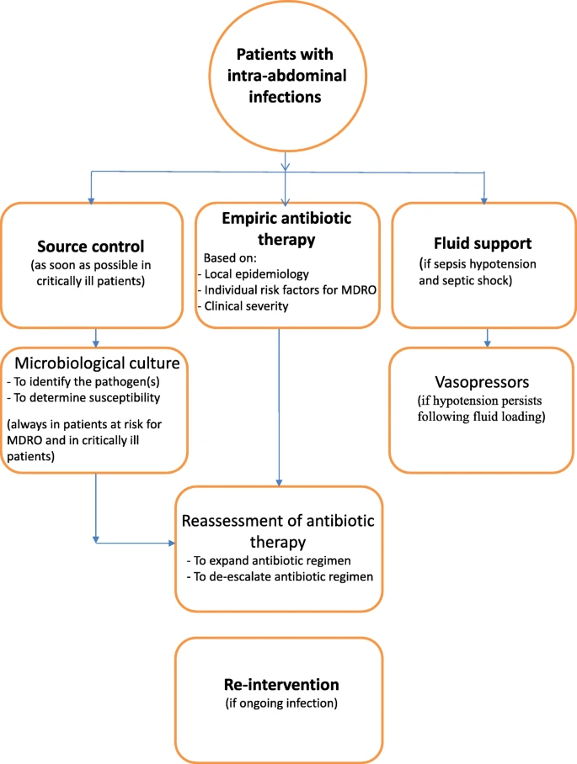

Slide 15
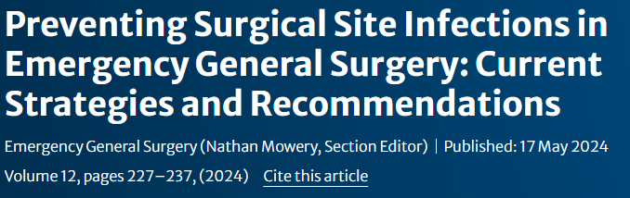
Data supporting wound protectors and routine wound irrigation are mixed, however, they are low-cost, low-risk options to help mitigate surgical site infections.
There are several advantages to intra-operative normothermia and glucose control for the prevention of SSI, which have been studied in elective and emergent surgical populations.
The management of contaminated general surgery wounds is controversial, but there is growing evidence to support the use of closed negative pressure wound therapy.

Slide 16
Grazie

